Slide 1
Programming Language II CSE-215
Prof. Dr. Mohammad Abu Yousuf
yousuf@juniv.edu

Slide 2
Data Types, Variables, and Arrays

Slide 3
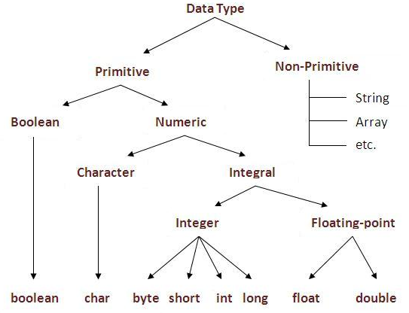
In java, there are two types of data types
primitive data types
non-primitive data types

Slide 4
Java defines eight primitive types of data: byte, short, int, long, char, float, double, and boolean. The primitive types are also commonly referred to as simple types. These can be put in four groups:
Integers This group includes byte, short, int, and long, which are for whole-valued signed numbers.
Floating-point numbers This group includes float and double, which represent numbers with fractional precision.
Characters This group includes char, which represents symbols in a character set, like letters and numbers.
Boolean This group includes boolean, which is a special type for representing true/false values.

Slide 5
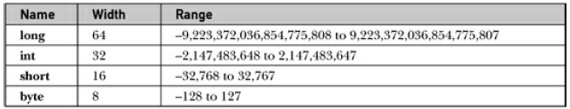
Integers
Java defines four integer types: byte, short, int, and long. All of these are signed, positive and negative values.

Slide 6
Integers
byte:
The smallest integer type is byte. This is a signed 8-bit type that has a range from −128 to 127.
Byte variables are declared by use of the byte keyword. For example, the following declares two byte variables called b and c:
byte b, c;

Slide 7
Integers
short:
short is a signed 16-bit type. It has a range from −32,768 to 32,767. It is probably the least-used Java type. Here are some examples of short variable declarations:
short s;
short t;

Slide 8
Integers
long:
long is a signed 64-bit type and is useful for those occasions where an int type is not large enough to hold the desired value.
For example, the following is a program that computes the number of miles that light will travel in a specified number of days:

Slide 9
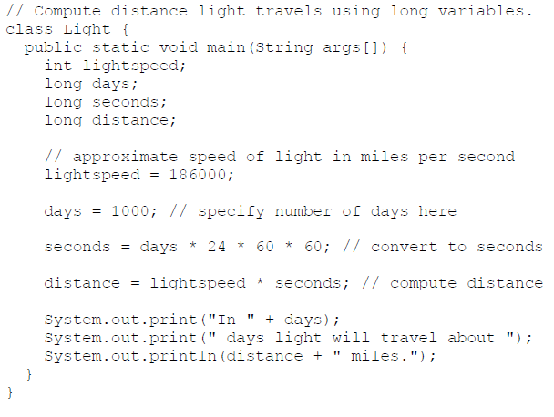
In 1000 days light will travel about 16070400000000 miles.

Slide 10
Characters
char in Java is not the same as char in C or C++. In C/C++, char is 8 bits wide. This is not the case in Java. Instead, Java uses Unicode to represent characters.
Unicode defines a fully international character set that can represent all of the characters found in all human languages. It is a unification of dozens of character sets, such as Latin, Greek, Arabic, Cyrillic, Hebrew, Katakana, Hangul, and many more.
For this purpose, it requires 16 bits. Thus, in Java char is a 16-bit type. The range of a char is 0 to 65,536. There are no negative chars.

Slide 11
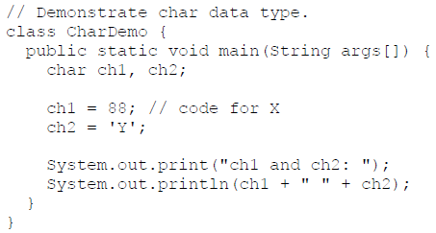
Characters
Here is a program that demonstrates char variables:
ch1 and ch2: X Y

Slide 12
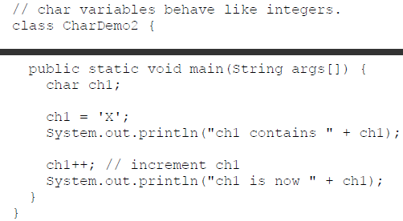
Characters
Notice that ch1 is assigned the value 88, which is the ASCII (and Unicode) value that corresponds to the letter X. As mentioned, the ASCII character set occupies the first 127 values in the Unicode character set.
ch1 contains X
ch1 is now Y

Slide 13
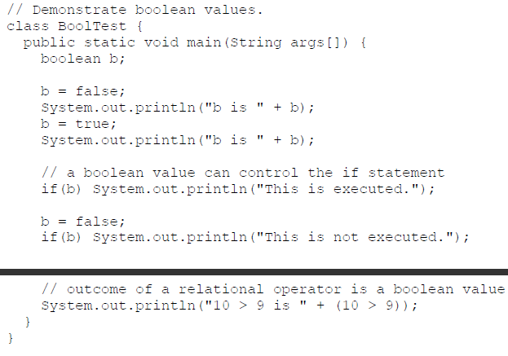
Booleans

Slide 14
Booleans
Output of previous program:
b is false
b is true
This is executed.
10 > 9 is true

Slide 15
Arrays
Arrays:
The general form of a one dimensional array declaration is:
dataType[] arr; (or)
dataType []arr; (or)
dataType arr[];
Example: int month_days[];
new is a special operator that allocates memory.
The general form of new as it applies to one-dimensional arrays appears as follows:
array-var = new type [size];
Example: month_days = new int[12];

Slide 16
Arrays
It is possible to combine the declaration of the array variable with the allocation of the array itself, as shown here:
int month_days[] = new int[12];
This is the way that you will normally see it done in professionally written Java programs.
Let’s review: Obtaining an array is a two-step process. First, you must declare a variable of the desired array type. Second, you must allocate the memory that will hold the array, using new, and assign it to the array variable. Thus, in Java all arrays are dynamically allocated.

Slide 17
Arrays
class Testarray{
public static void main(String args[]){
int a[]=new int[5];//declaration and instantiation
a[0]=10;//initialization
a[1]=20;
a[2]=70;
a[3]=40;
a[4]=50;
//printing array
for(int i=0;i<a.length;i++)//length is the property of array
System.out.println(a[i]);
}
}

Slide 18
Passing Array to method in java
class Testarray2{
static void min(int arr[]){
int min=arr[0];
for(int i=1;i<arr.length;i++)
if(min>arr[i])
min=arr[i];
System.out.println(min);
}
public static void main(String args[]){
int a[]={33,3,4,5};
min(a);//passing array to method
}
}
Output: 3

Slide 19
Multidimensional Arrays
Multidimensional Arrays:
In Java, multidimensional arrays are actually arrays of arrays.
To declare a multidimensional array variable, specify each additional index using another set of square brackets.
For example, the following declares a two-dimensional array variable called twoD:
dataType[][] arrayRefVar; (or)
dataType [][]arrayRefVar; (or)
dataType arrayRefVar[][]; (or)
dataType []arrayRefVar[];
Example:
int twoD[][] = new int[4][5];

Slide 20
Multidimensional Arrays
class Testarray3{
public static void main(String args[]){
//declaring and initializing 2D array
int arr[][]={{1,2,3},{2,4,5},{4,4,5}};
//printing 2D array
for(int i=0;i<3;i++){
for(int j=0;j<3;j++){
System.out.print(arr[i][j]+" ");
}
System.out.println();
}
}}
Output:1 2 3 2 4 5
4 4 5

Slide 21
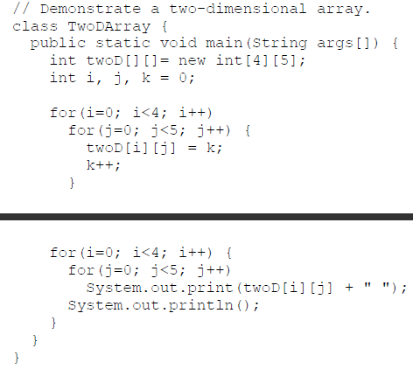
Multidimensional Arrays
Example:
0 1 2 3 4
5 6 7 8 9
10 11 12 13 14
15 16 17 18 19

Slide 22
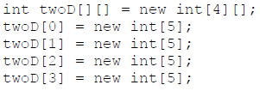
Multidimensional Arrays
When you allocate memory for a multidimensional array, you need only specify the memory for the first (leftmost) dimension.
You can allocate the remaining dimensions separately.
For example, this following code allocates memory for the first dimension of twoD when it is declared. It allocates the second dimension manually.

Slide 23
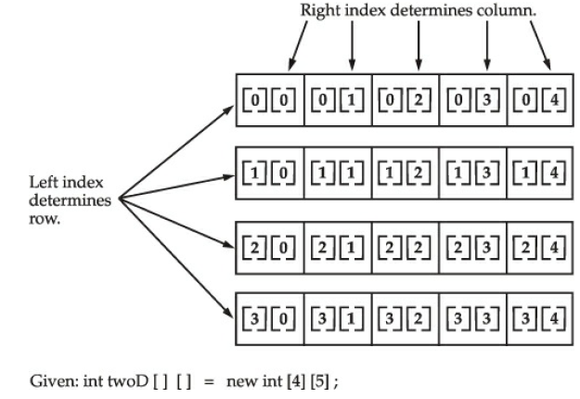
Multidimensional Arrays

Slide 24
Multidimensional Arrays
when you allocate dimensions manually, you do not need to allocate the same number of elements for each dimension.
Since multidimensional arrays are actually arrays of arrays, the length of each array is under your control. For example, the following program creates a two dimensional array in which the sizes of the second dimension are unequal:

Slide 25
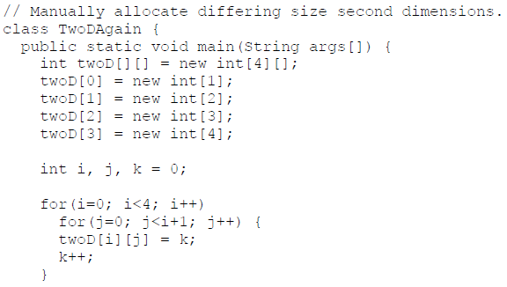

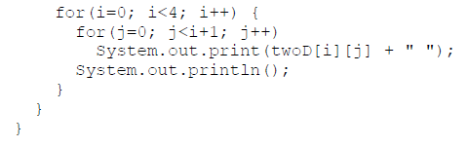

Slide 26
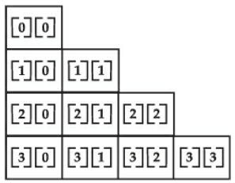
Multidimensional Arrays
The array created by this program looks like this:
The use of uneven (or irregular) multidimensional arrays may not be appropriate for many applications, because it runs contrary to what people expect to find when a multidimensional array is encountered. However, irregular arrays can be used effectively in some situations.

Slide 27
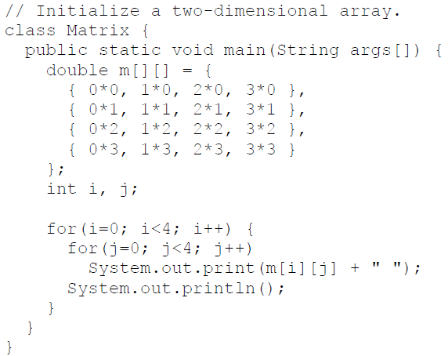

Multidimensional Arrays
It is possible to initialize multidimensional arrays. To do so, simply enclose each dimension’s initializer within its own set of curly braces. The following program creates a matrix where each element contains the product of the row and column indexes.

Slide 28
Alternative Array Declaration Syntax
There is a second form that may be used to declare an array:
type[ ] var-name;
Here, the square brackets follow the type speci􀉹er, and not the name of the array variable.
For example, the following two declarations are equivalent:
int al[ ] = new int[3];
int[ ] a2 = new int[3];
The following declarations are also equivalent:
char twod1[ ][ ] = new char[3][4];
char[ ][ ] twod2 = new char[3][4];

Slide 29
Alternative Array Declaration Syntax
This alternative declaration form offers convenience when declaring several arrays at the same time. For example,
int[] nums, nums2, nums3; // create three arrays
creates three array variables of type int. It is the same as writing
int nums[], nums2[], nums3[]; // create three arrays

Slide 30
What is the class name of java array?
In java, array is an object. For array object, an proxy class is created whose name can be obtained by getClass().getName() method on the object.
class Testarray4{
public static void main(String args[]){
int arr[]={4,4,5};
Class c=arr.getClass();
String name=c.getName();
System.out.println(name);
}}
Output: I

Slide 31
Call by value in java
There is only call by value in java, not call by reference.
If we call a method passing a value, it is known as call by value. The changes being done in the called method, is not affected in the calling method.
class Operation{
int data=50;
void change(int data){
data=data+100;//changes will be in the local variable only
}
public static void main(String args[]){
Operation op=new Operation();
System.out.println("before change "+op.data);
op.change(500);
System.out.println("after change "+op.data);
}
}
Output:
before change 50
after change 50
In case of call by value original value is not changed.

Slide 32
Call by reference in java
class Operation2{
int data=50;
void change(Operation2 op){
op.data=op.data+100;//changes will be in the instance variable
}
public static void main(String args[]){
Operation2 op=new Operation2();
System.out.println("before change "+op.data);
op.change(op);//passing object
System.out.println("after change "+op.data);
}
}
In case of call by reference original value is changed if we made changes in the called method.
If we pass object in place of any primitive value, original value will be changed. In this example we are passing object as a value.

Slide 33

A Few Words About Strings
The String type is used to declare string variables. You can also declare arrays of strings. A quoted string constant can be assigned to a String variable.
Here, str is an object of type String. It is assigned the string “this is a test”.

Slide 34
Thank You

